Slide 1
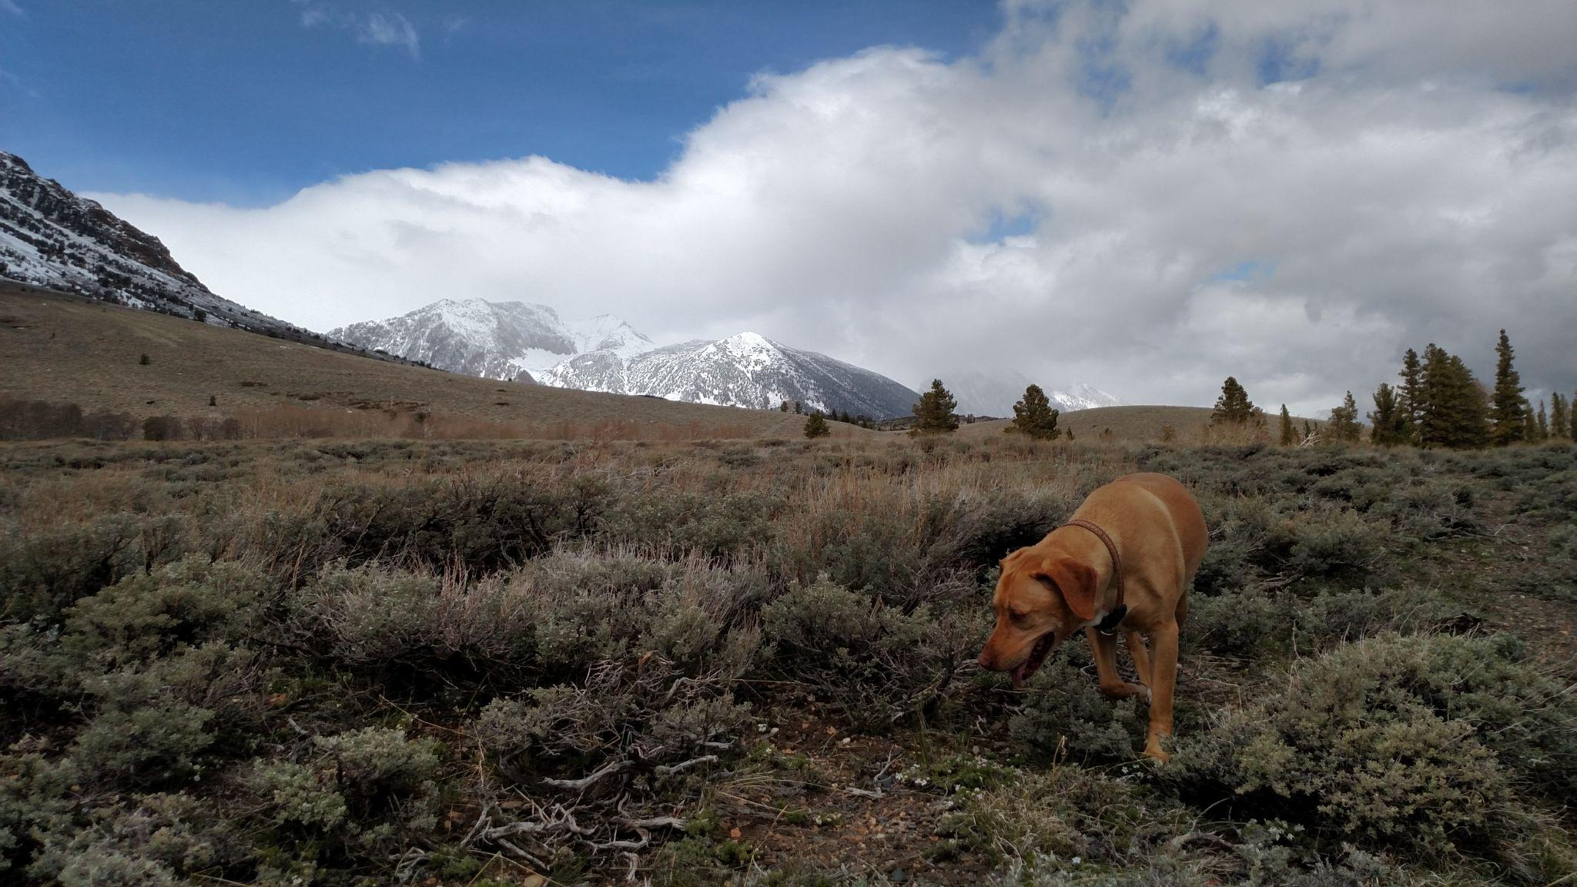
Refrigeration of the Western Cordilleran Lithosphere During Laramide Shallow-Angle Subduction
Dumitru, Gans, Foster and Miller (1997)

Slide 2
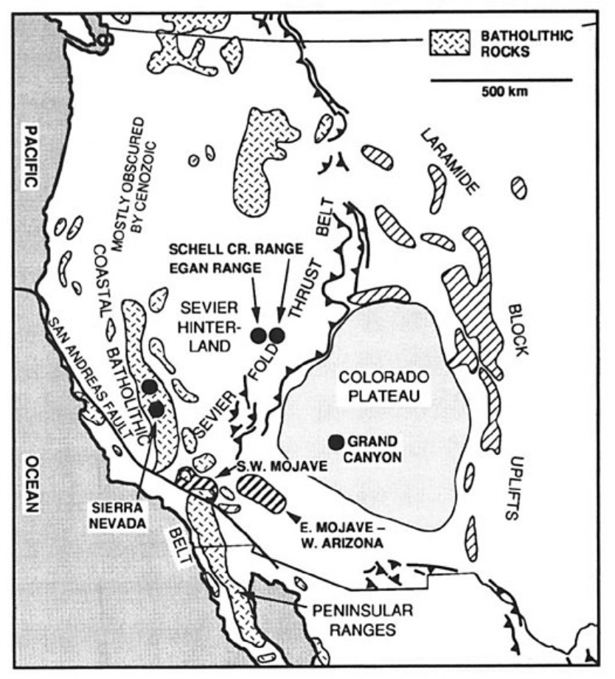
Pre- Laramide Western US was volcanically active near coast.
. This was ~80 Ma
. Related to normal angle subduction
Shifted to a shallow subduction causing widespread Lithospheric refrigeration.

Slide 3
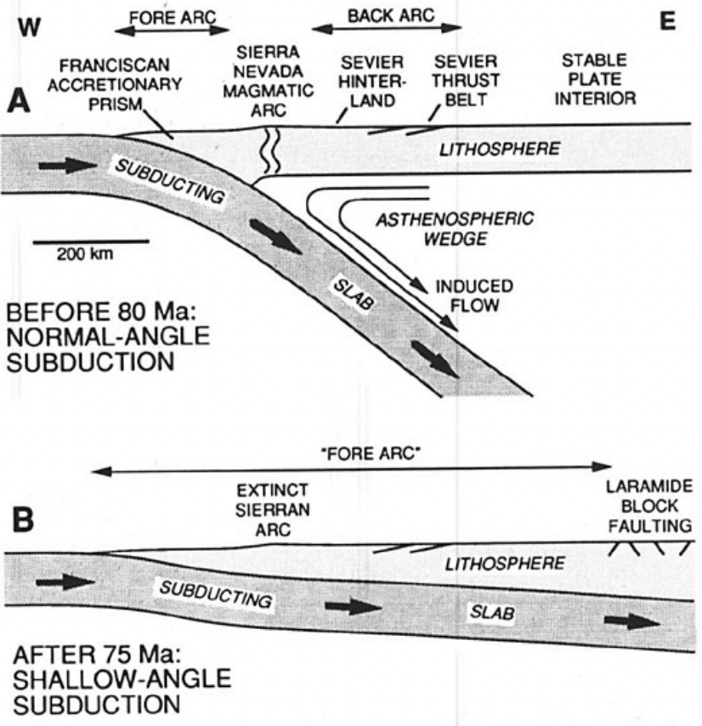
Lots of magmatism in the Sierra before 80 Ma.
Geothermal gradients in Western Cordillera were normal to high due to hot wedge.
Normal subduction switched to Shallow angle subduction.
Caused magmatism to migrate East.
Shifted Western Cordillera into a cold thermal setting

Slide 4
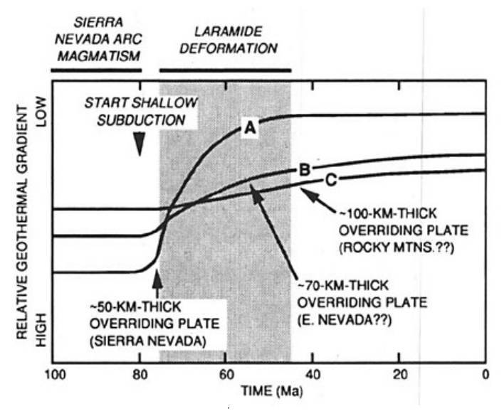
Thermochronologic data records evidence of refrigeration in: Sierra Nevada, Great Basin, Mojave Desert, Western AZ, and (Maybe) Colorado Plateau.
Important implications of refrigeration:
  Metamorphism in the Western Cordillera would have waned.
  Crust in west Cordillera would have strengthened.
  Isotopic cooling ages may not be valid indicators of a period of major uplift.
Thick lithosphere (>100 km) means cooling at shallow levels would leave no clear isotopic age signature (K-Ar).

Slide 5
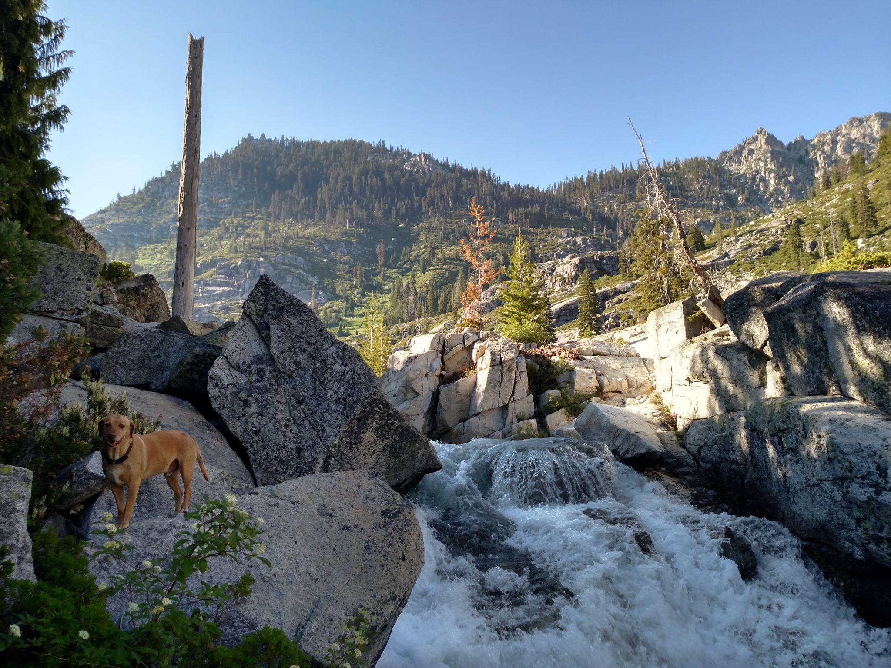
Evidence for refrigeration in Sierra Nevada
Arc magmatism ceased ~80 Ma.
Thermal gradients remained high in the Sierra (~50deg C/km) 5-10 years after.
Then decreases to ⅕ or less.
Tertiary gradients range from 5-15 C/km
Modeling suggests subducting slab rose to 35-60 km beneath Sierra to produce time lag of cooling.

Slide 6
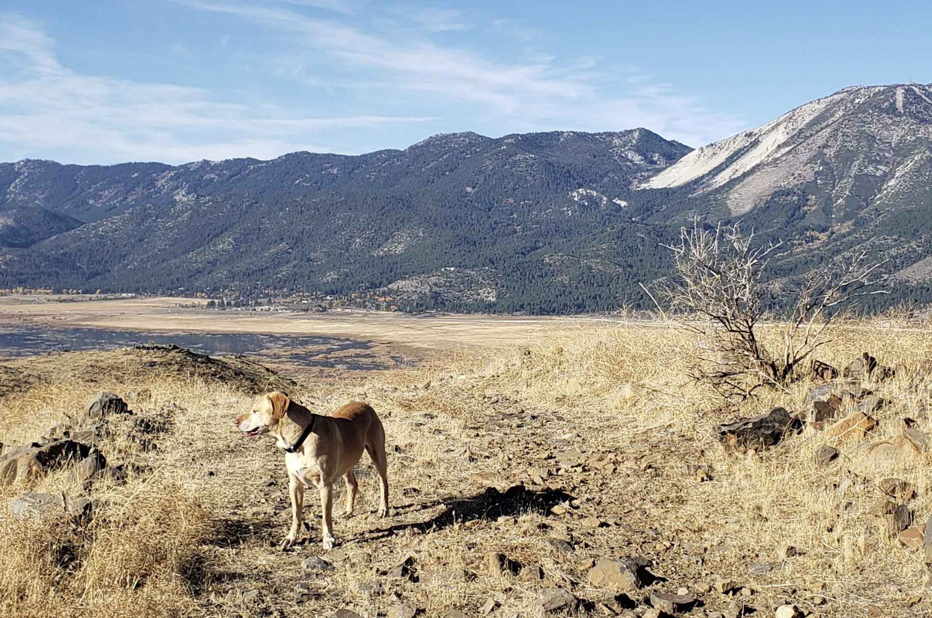
Evidence for refrigeration in the Great Basin
Termochron data indicate pronounced cooling 74-45 Ma.
Mid crustal temperatures in the early Tertiary were substantially lower than in the Mesozoic.
Show overall decreasing thermal gradients deep in paleodepth of 10-12 km to top of crust.

Slide 7
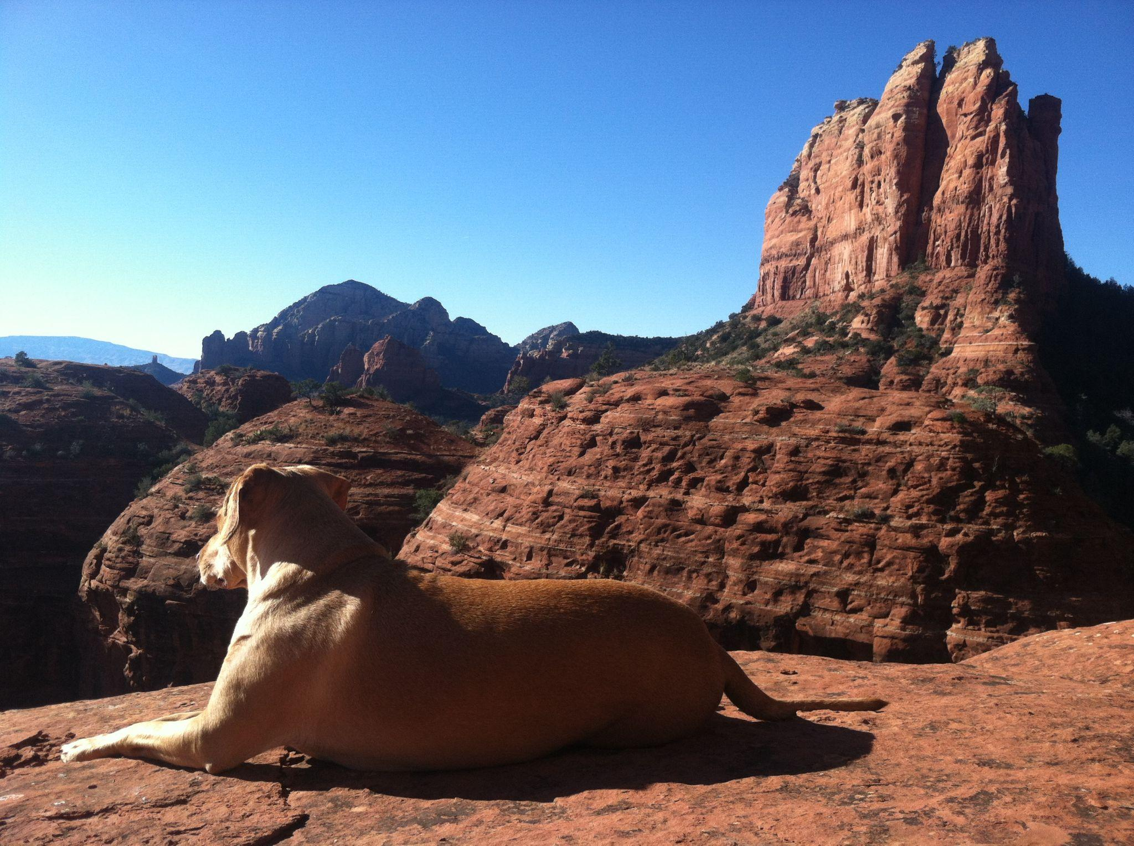
Evidence for refrigeration: Mojave Desert and Western AZ
Concordant K-Ar ages that cluster between the 75-65 Ma.
Old Woman Mountains retain evidence of both local Late Cretaceous unroofing and subsequent regional crust refrigeration.

Slide 8
Evidence for refrigeration: Colorado Plateau
Apatite fission-track data from the bottom of Grand canyon indicate cooling ~70 Ma.
Rocks from Phantom Ranch cooled from 130 to 40 C.
Refrigeration could be considered an alternate possibility since cooling is relatively small.

Slide 9
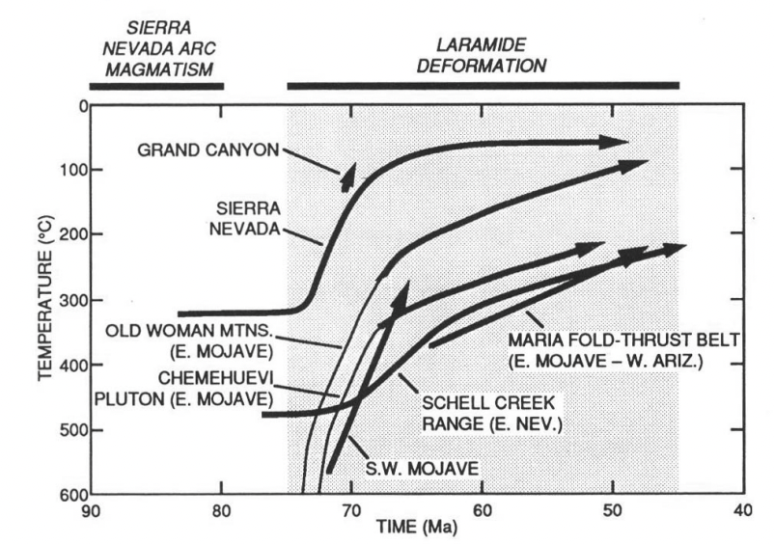
Temperature- time plots for various locations in Cordillera based on K-Ar, fission-track and ‘other data’.
Shows cooling at the beginning of Laramide orogeny.
Thick lines are cooling attributed to subduction induced refrigeration.
Thin line is showing cooling attributed to movement on western Old Woman Mountains.

